Slide 1


Analyzing
Social Buzz

Slide 2


Today's agenda
Project recap
Problem
The Analytics team
Process
Insights
Summary

Slide 3

Social Buzz is an emerging technology unicorn that needs assistance to adapt quickly to it’s global scale.
Accenture with their expertise is assisting them with these tasks:
Project Recap
An audit of their big data practice
Recommendation for a successful IPO
Analysis of data to evaluate Social Buzz’s Top 5 content category

Slide 4


Problem
Social Buzz has
100000 posts per day…
…365000000 posts per year
How to monetize with such huge numbers?
Analysis to identify the Top 5 categories that trend in their platform

Slide 5



Andrew Fleming
(Chief Technical Architect)
The Analytics team
Marcus Rompton
(Senior Principle)
Pritam Chakraborty
(Data Analyst)

Slide 6
Process
1
Data Collection
2
Data Understanding
3
Data cleaning and modelling
4
Analysis and Visualization
5
Insights Extraction

Slide 7

Insights
16
24573
962
Unique Categories
Number of reactions
Number of posts

Slide 8
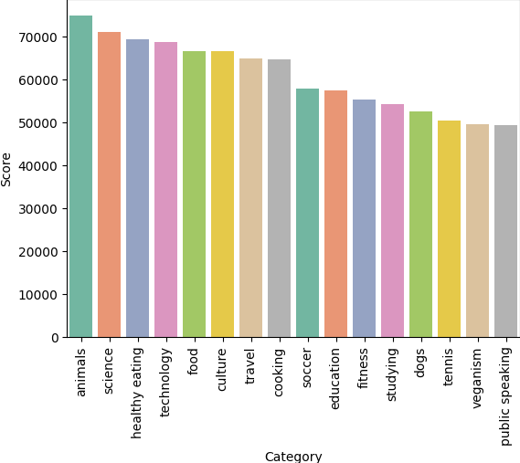
Top 5 Categories based on Scores
Animals
Science
Healthy eating
Technology
Food
Animals category also has the
1897
Highest number of Reactions…
69
Highest number of Posts…

Slide 9
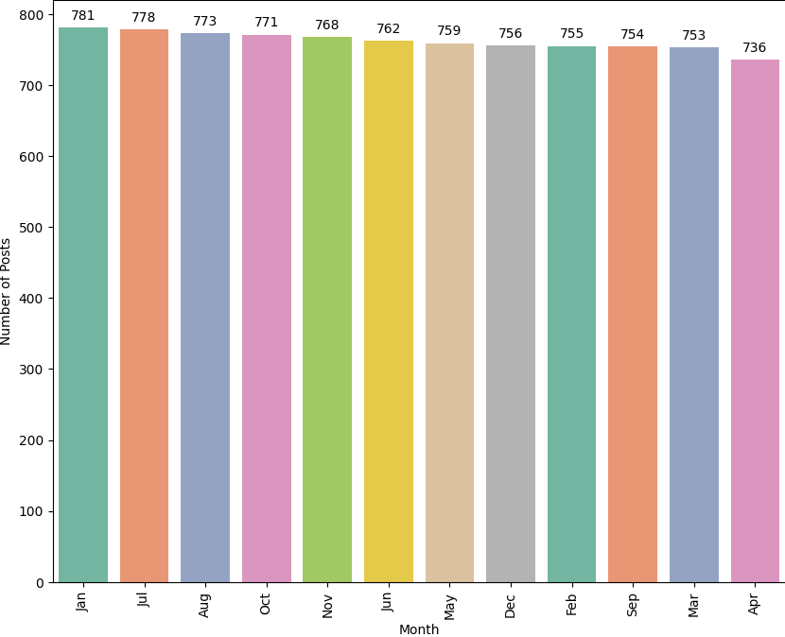
The highest number of posts were made on the month of January
But the difference in number of posts is not that pronounced indicating almost an uniform activity of users throughout the months

Slide 10

Animals, Science and Technology are some of the popular categories, indicating the user base consume more of “real-life”, ‘factual” and “application based” content.
Two of popular categories, “Healthy eating” and “Food”, are related, and with healthy eating ranking highest indicates users are conscious in their lifestyle. This insight can be used to target ads for products or campaigns with health brands to boost engagement.
Summary
Future steps
This analysis provide a stepping stone to the global market. It’s time to take the analysis to large scale production for real time evaluation and understanding of the business. The Accenture team are here to show you how to do this.

Slide 11

Thank you!
ANY QUESTIONS?

